Slide 1
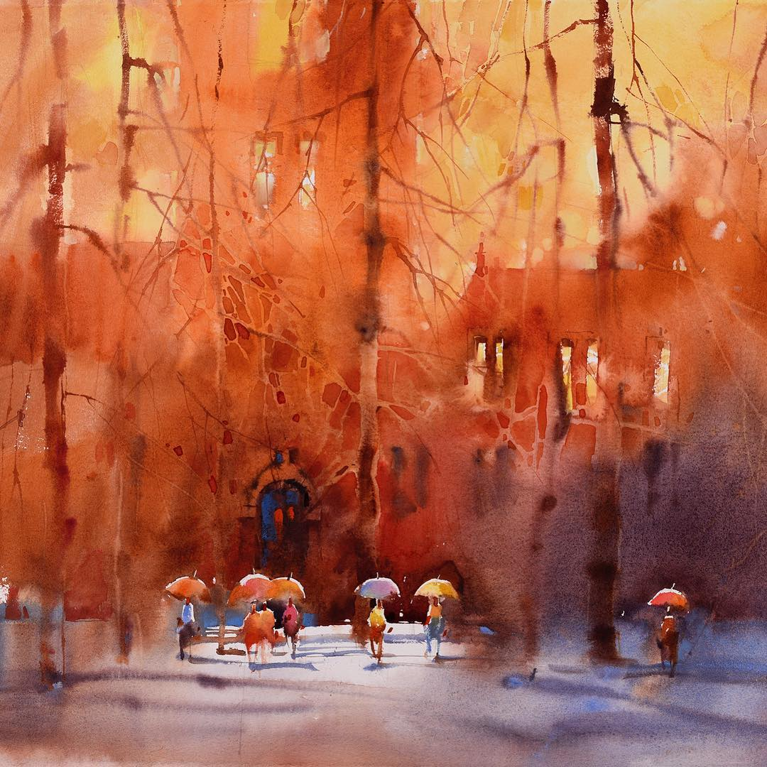
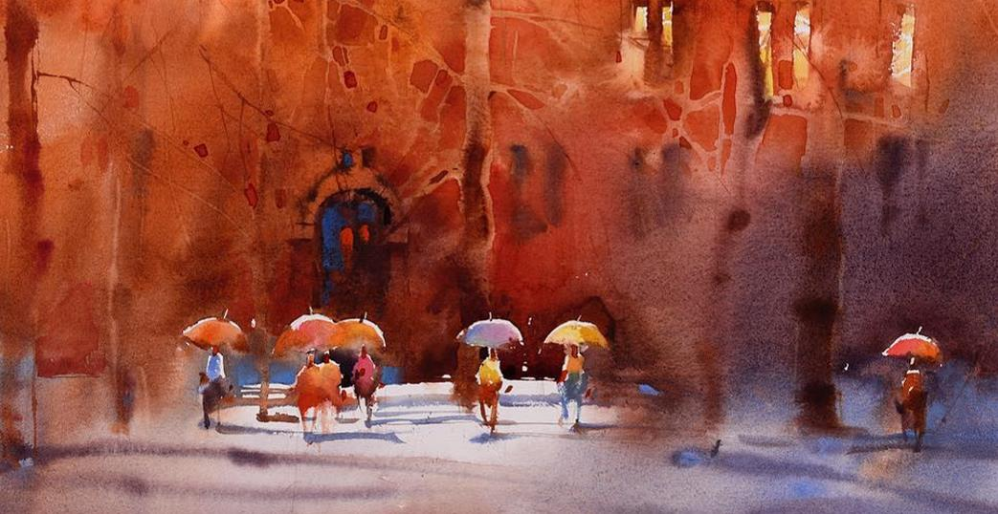
Absurd DreamDesign
Dead sleep
Perhaps love is not passion, nor nostalgia, but years, years have become a part of life，If you know me before, maybe you will forgive me now
This template is designed by absurd dream

Slide 2
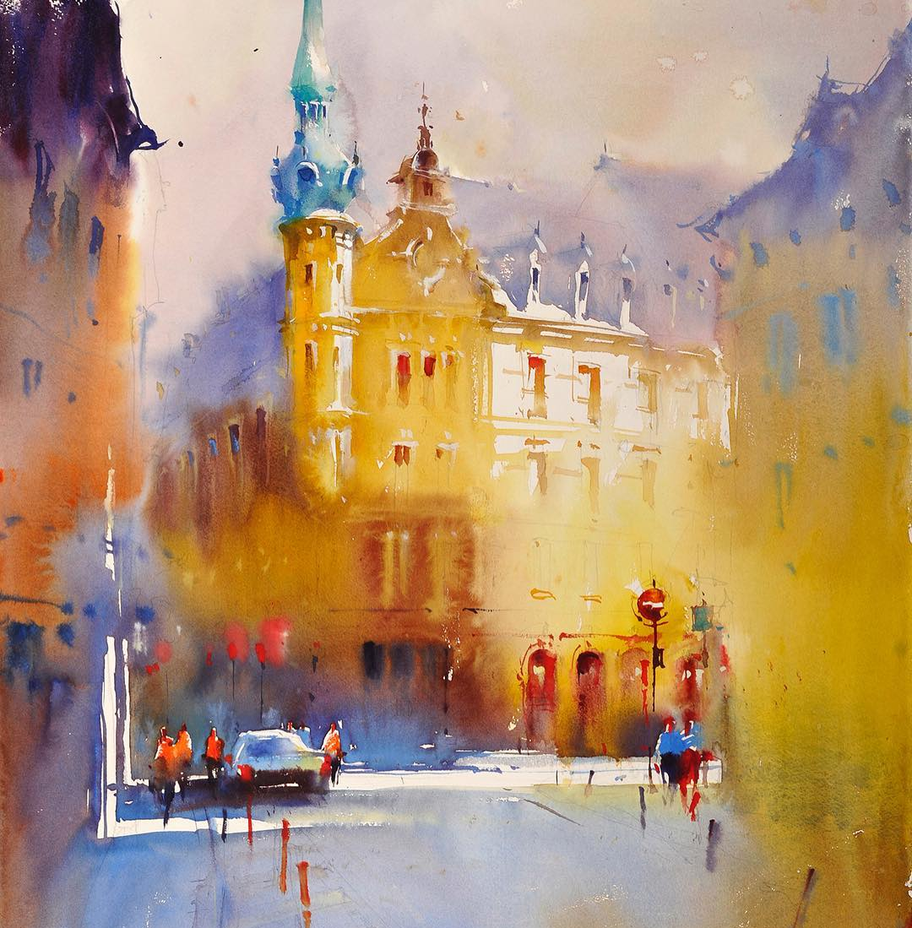
Dead sleep
The moon you promised didn't appear, but I didn't sleep, or I just loved you all night in cold weather.
Those really important things will survive the destruction of rational analysis in the daytime, and then return to their original status at night
Absurd DreamDesign

Slide 3
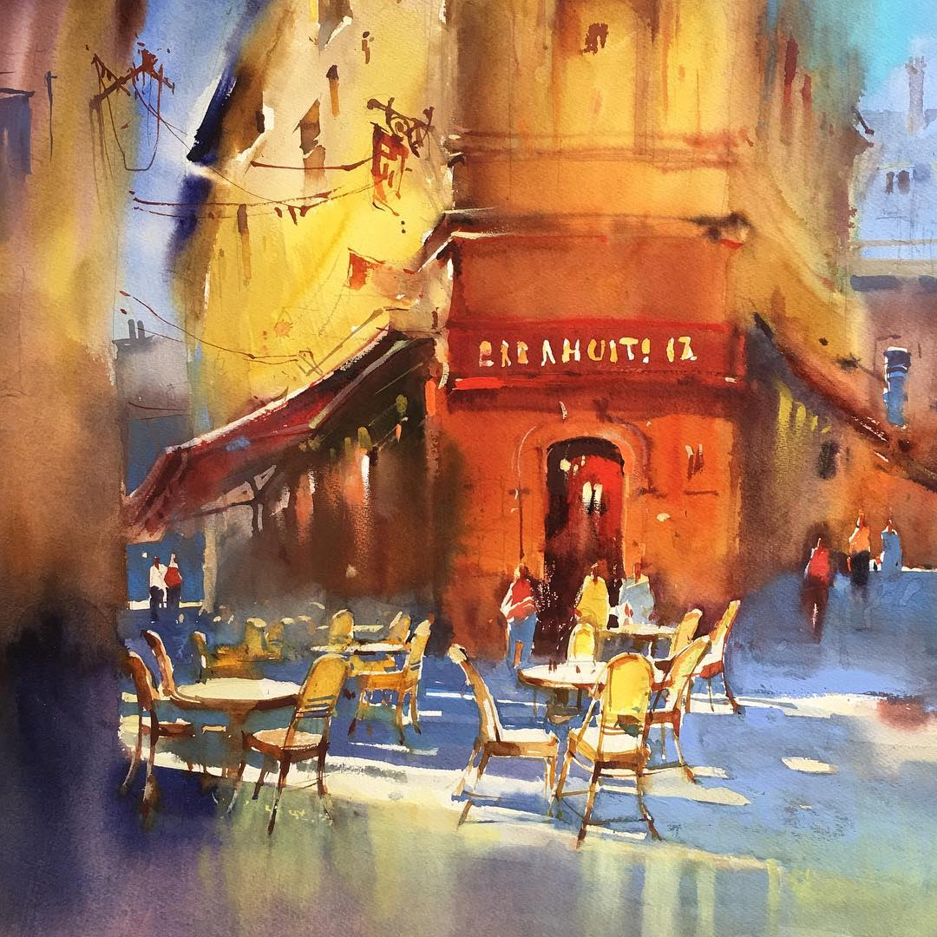
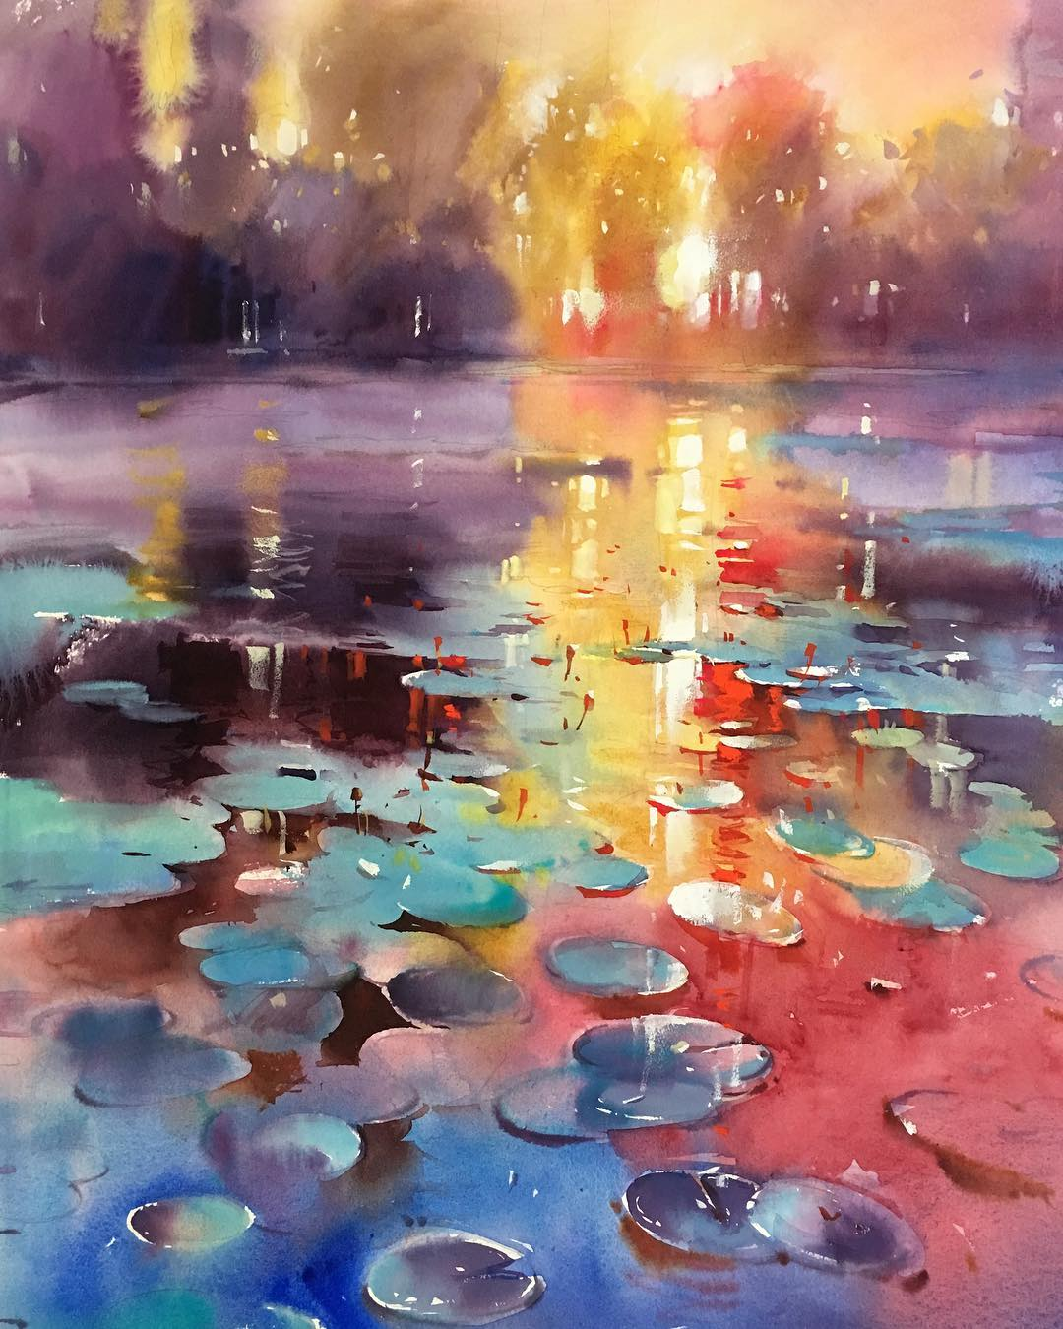
Absurd DreamDesign
The moon you promised didn't appear, but I didn't sleep, or I just loved you all night in cold weather.
Those really important things will survive the destruction of rational
Absurd DreamDesign

Slide 4
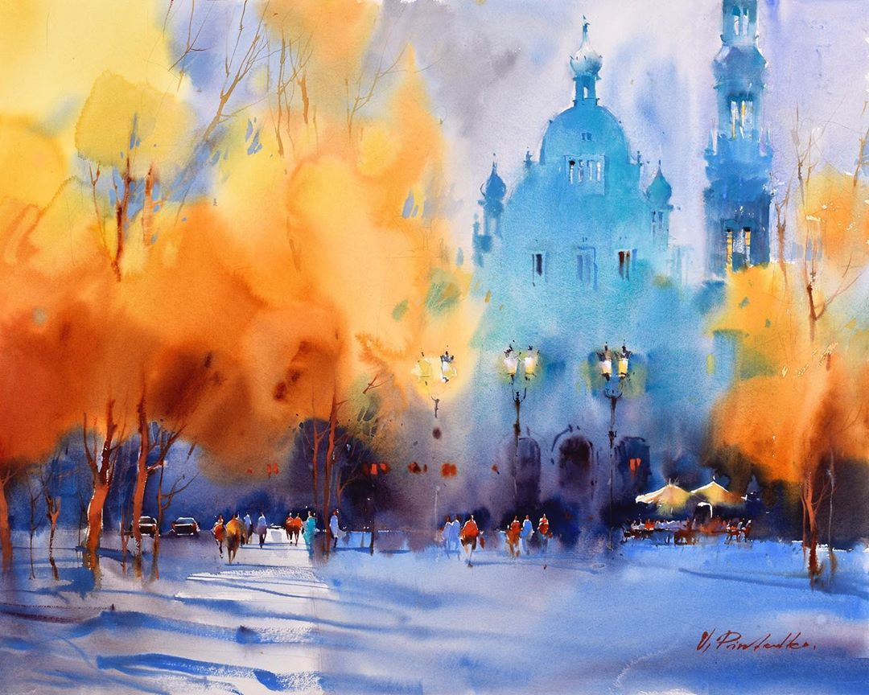
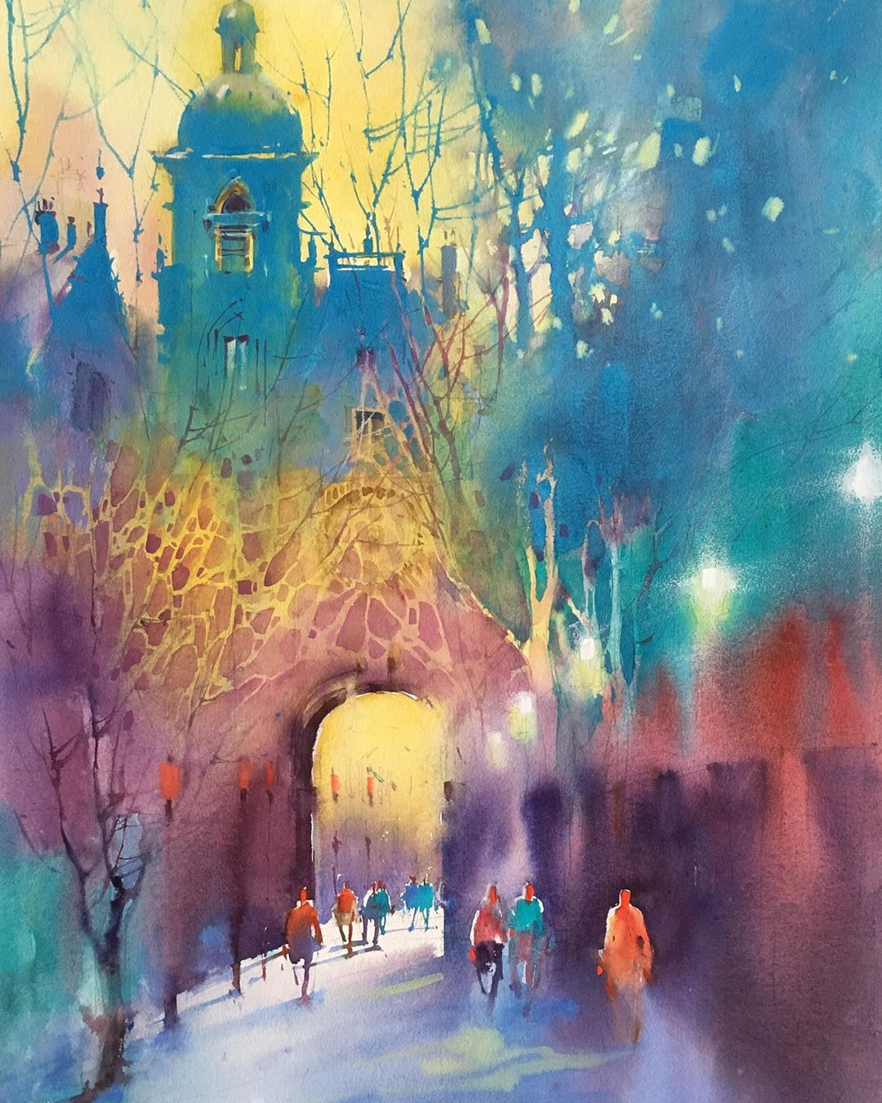
Absurd DreamDesign
Those really important things will survive the destruction of rational analysis in the daytime, and then return to their original status at night
Absurd DreamDesign
Absurd DreamDesign

Slide 5
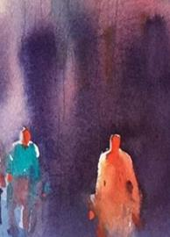
MIDSUMMER DREAM
Absurd DreamDesign
Those really important things will survive the destruction of rational analysis in the daytime, and then return to their original status at night

Slide 6
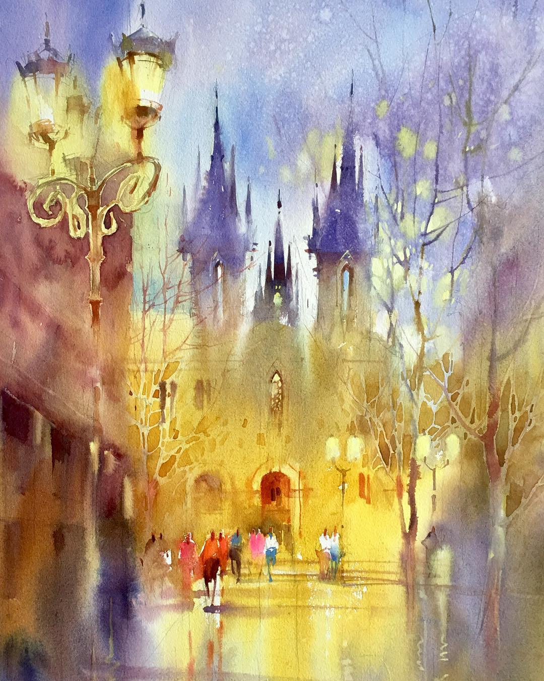
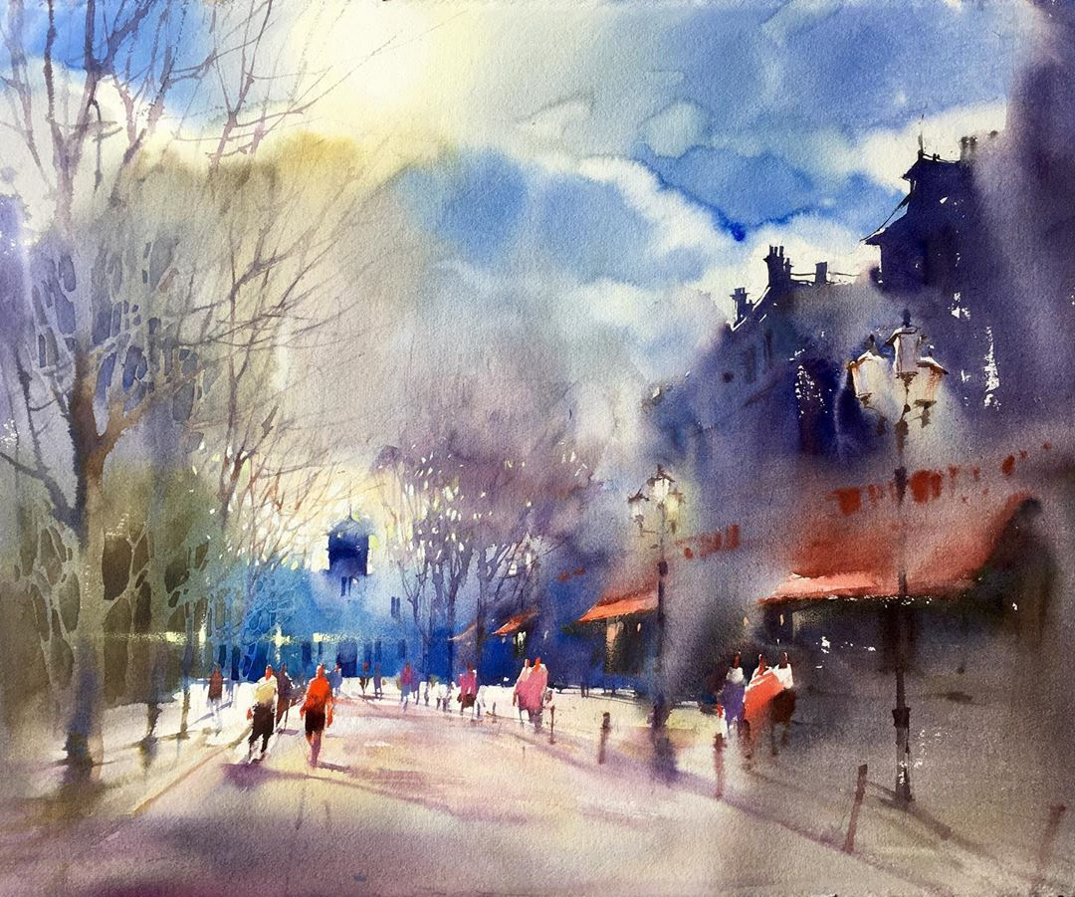
Absurd DreamDesign
Dead sleep
Absurd DreamDesign
The moon you promised didn't appear, but I didn't sleep, or I just loved you all night in cold weather.
Those really important things will survive the destruction of rational analysis in the daytime, and then return to their original status at night

Slide 7
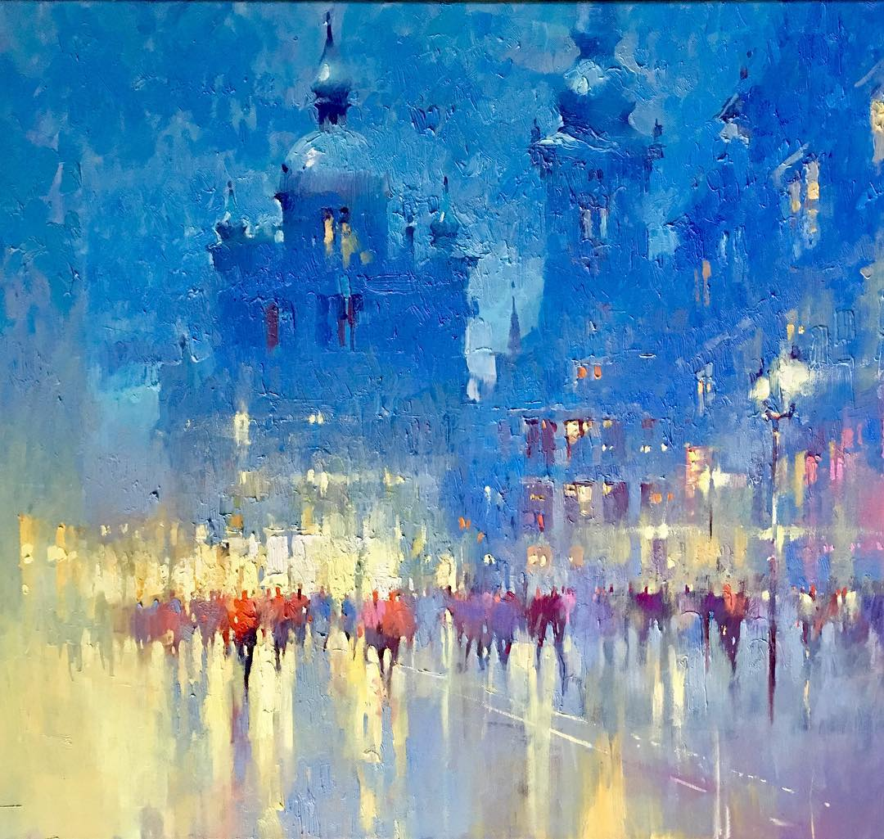
MIDSUMMER DREAM
Absurd DreamDesign
MIDSUMMER DREAM
Those really important things will survive the destruction of rational analysis in the daytime, and then return to their original status at night

Slide 8
Absurd DreamDesign
Dead sleep
The moon you promised didn't appear, but I didn't sleep, or I just loved you all night in cold weather.
Those really important things will survive the destruction of rational analysis in the daytime, and then return to their original status at night
Absurd DreamDesign

Slide 9
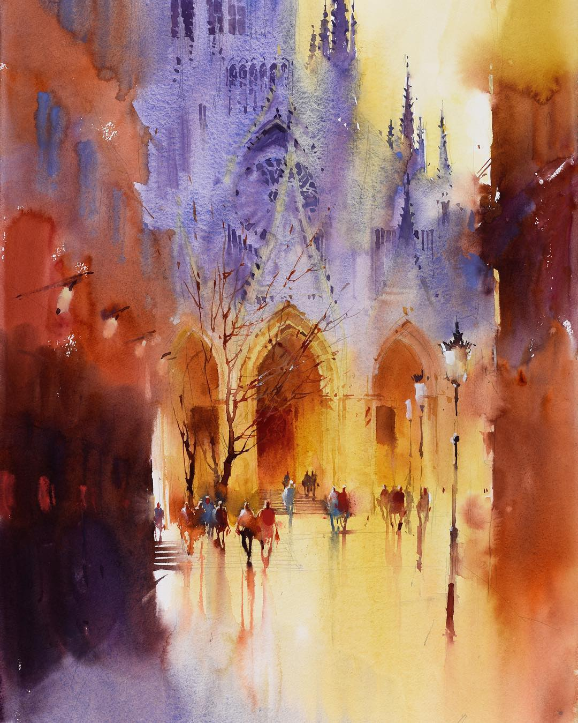
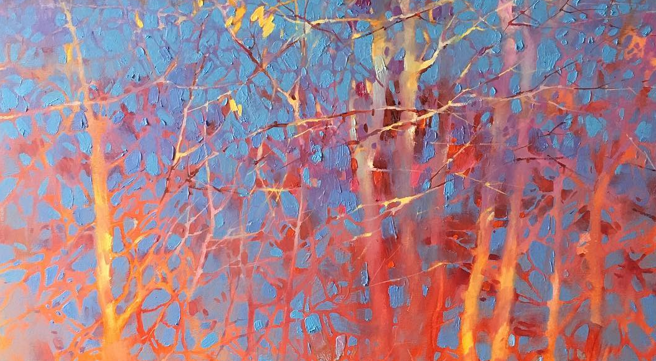
Absurd DreamDesign
Those really important things will survive the destruction of rational analysis in the daytime, and then return to their

Slide 10
Absurd DreamDesign
THANK YOU
Perhaps love is not passion, nor nostalgia, but years, years have become a part of life，If you know me before, maybe you will forgive me now
This template is designed by absurd dream

